Slide 1

San Diego Hearts
Regional Variation Analysis
Coronary Heart Disease
Akshit Bhatnagar, Disha Singla, Ehab Abdelmaguid, Michael Galarnyk, Orysya Stus
Team 203 DataPros

Slide 2
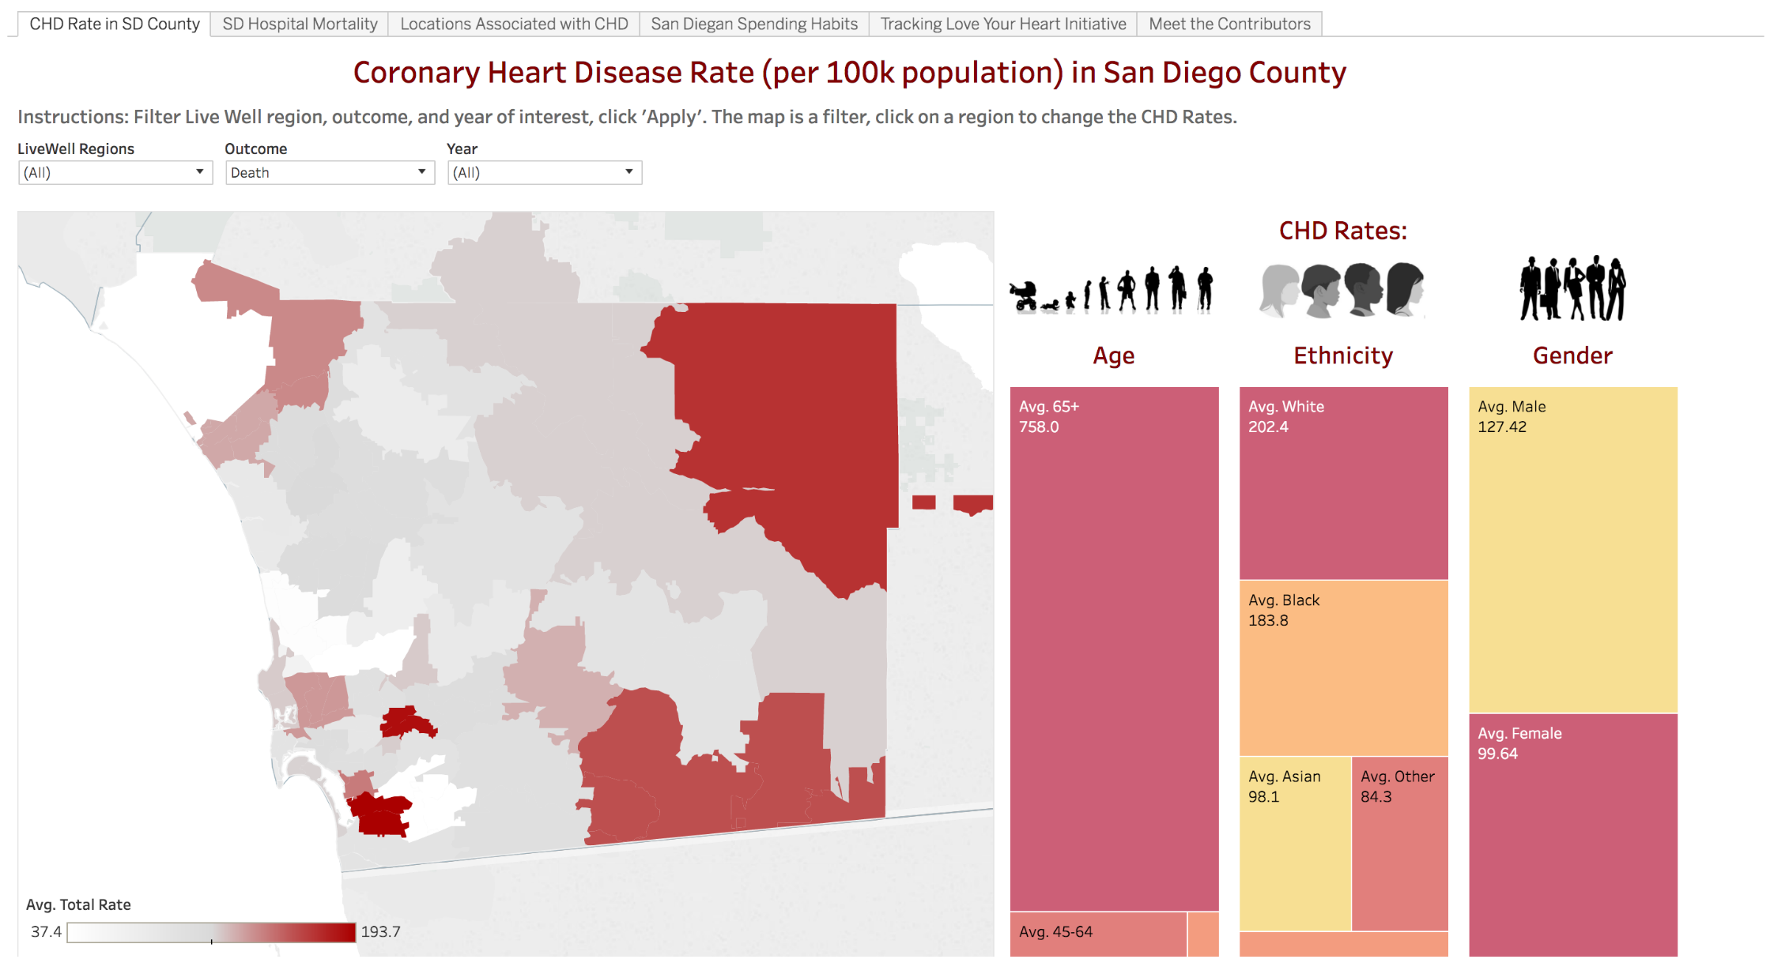
Regional Variation Analysis
Total Cases for:
United States: 801,000
California: 78,000
San Diego: 3,229
Del Mar-Mira Mesa (Least cases )
Chula Vista
(Most cases)

Slide 3





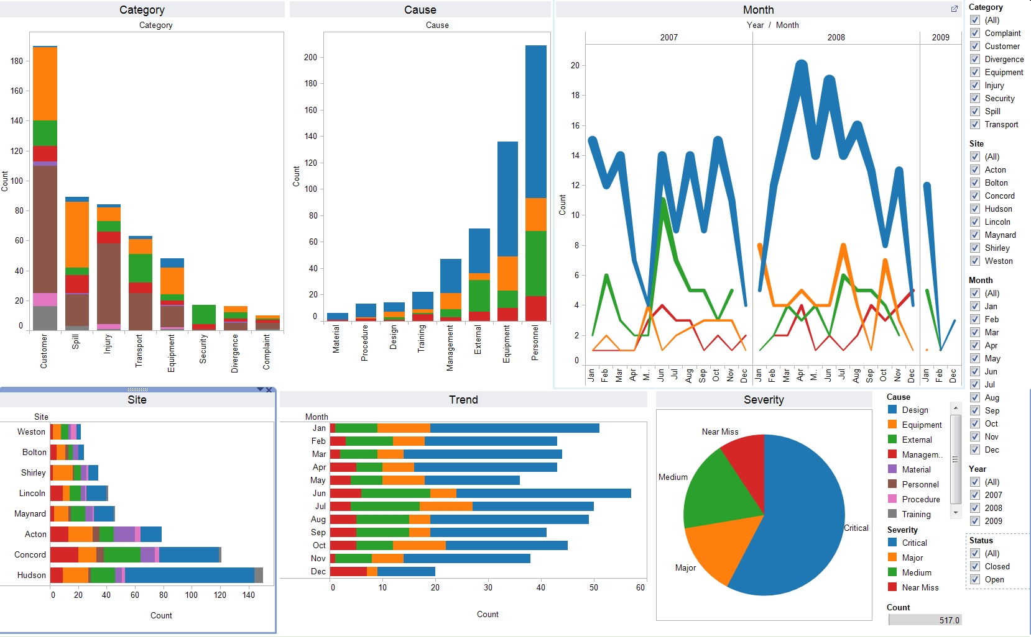








Datasets
Tools
Product
Process and Datasets

Slide 4
Demographics
Ethnicity
Education
Income
Age

Slide 5
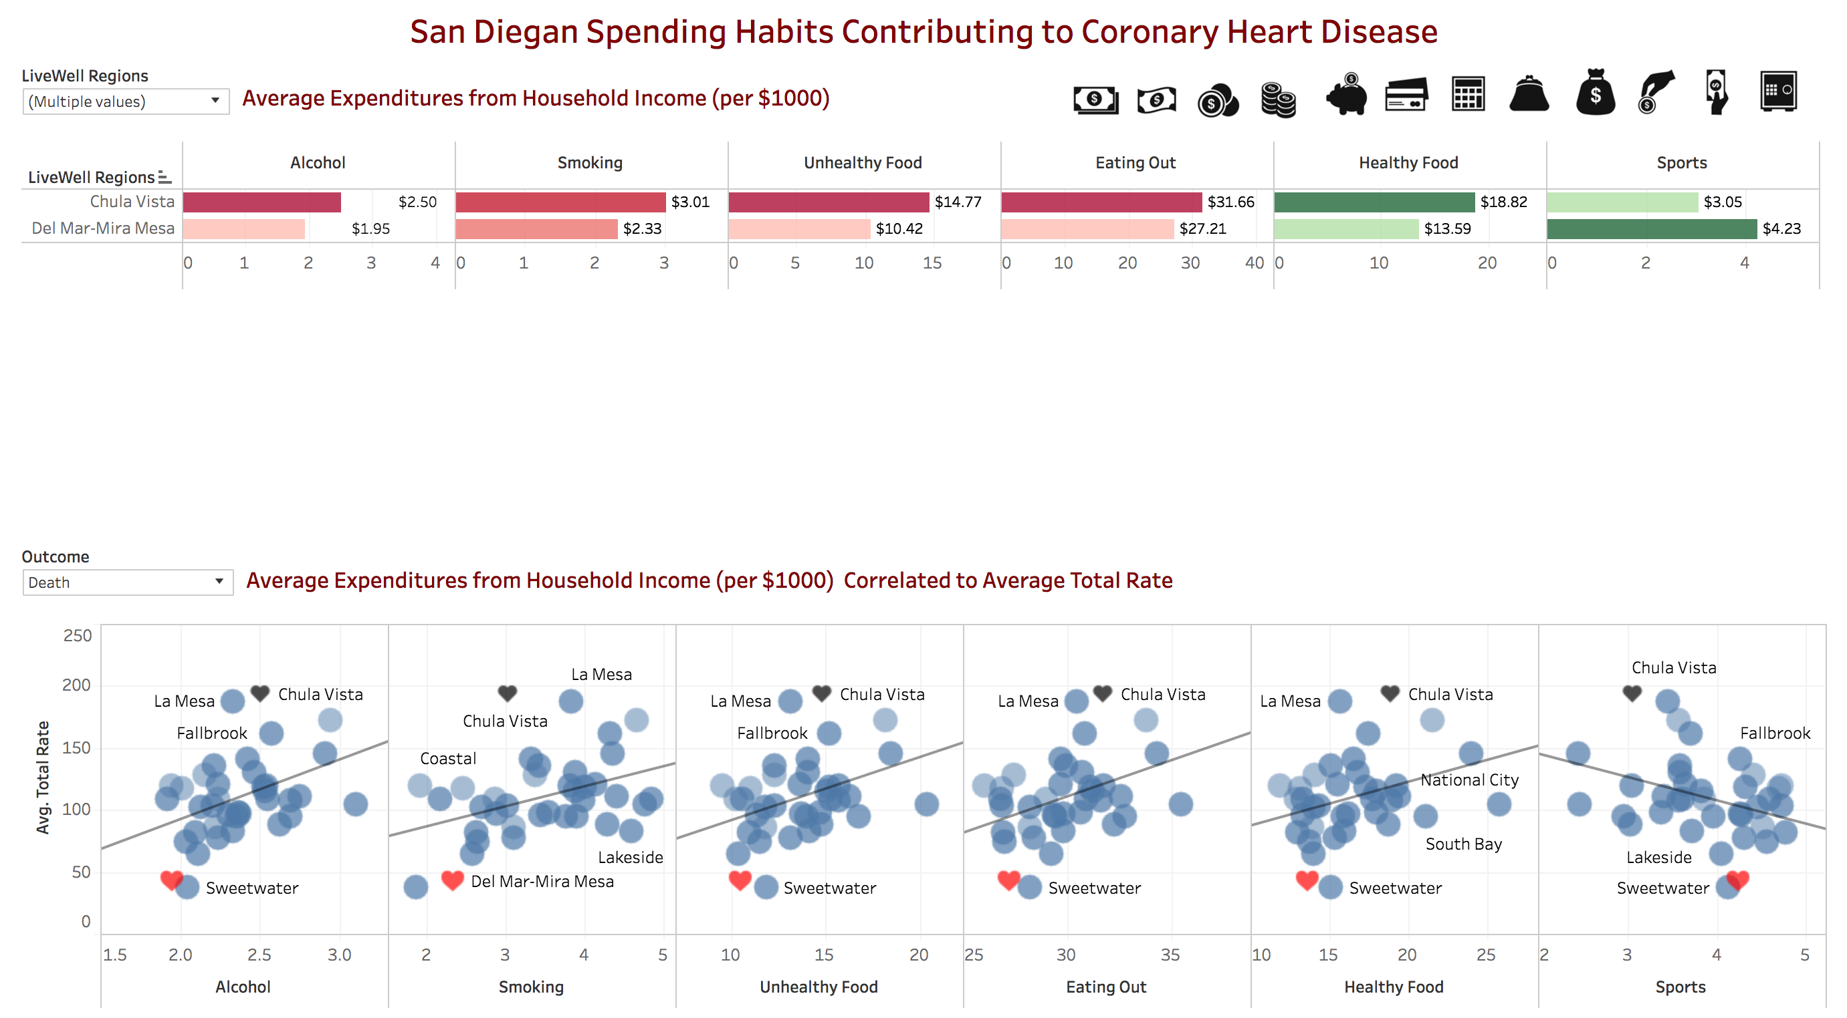
Lifestyle
Chula Vista Spent: | 28% More | 29% More | 42% More | 16% More | 38% More | 27% Less

Slide 6
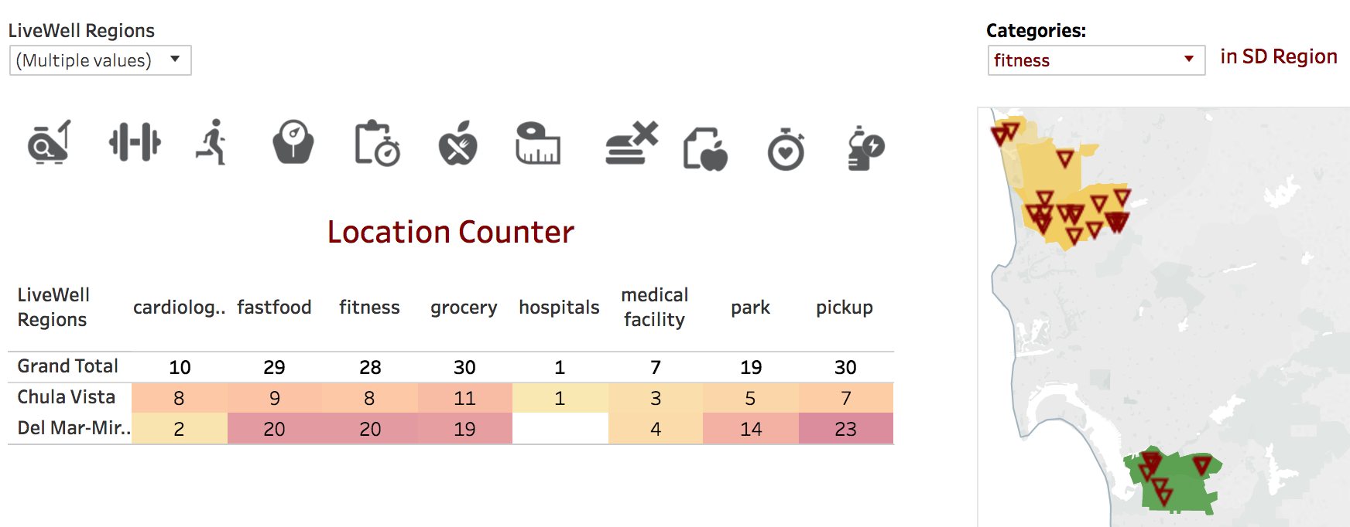
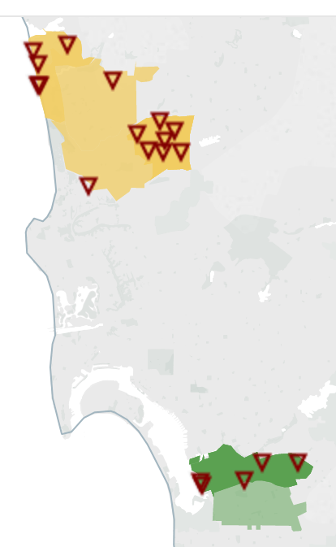
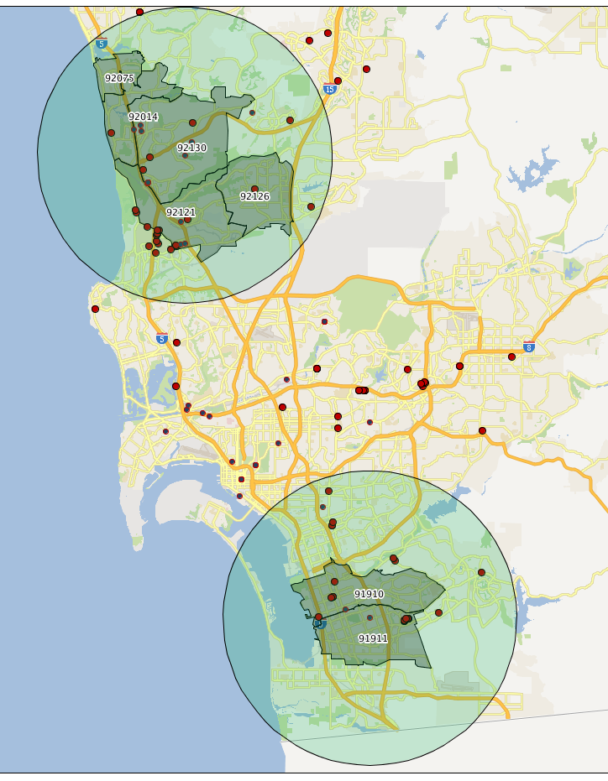
Amenities Available
Fitness Centers
Parks
Cardiologists
The number of fitness centers, parks, and
cardiologists (within 7 mile radius) is higher
in the Del Mar-Mira Mesa.

Slide 7
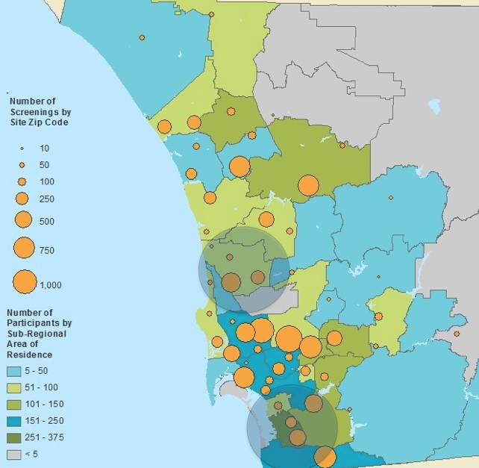
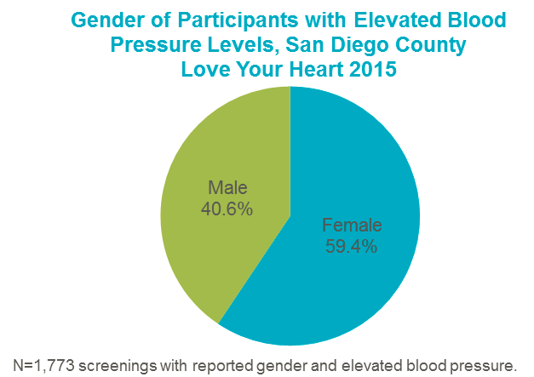
Future Prospects
Potential Users:
San Diego general public, Health Care Delivery Systems (Outreach), community workers, epidemiologists, hospitals (site location), Public Health Department
Future Prospects:
Alert systems (preventing epidemics), answering ‘what ifs’ utilizing learning algorithms, expand it to analyze other health concerns and further evaluating correlations
Making San Diego campaigns more data-driven
DEMO TIME…

